Slide 1
CAUSE OF DEATH

Slide 2
Problem statement
A dataset contain data of cause of deaths due to different reasons from year 1990 to 2019 of 204 different countries.
We have to visualize this data to find some key information.

Slide 3
After understanding and know the facts of data
Following are the trends and data that we have to find out:
Top 5 maximum deaths in which country
From top 5 we will find out top 2 country with maximum deaths
We will find out total no. of deaths with respect to year
Main cause of deaths and and their trends year-wise
Top 10 main cause of deaths with maximum deaths and their trends
Year with maximum number of Deaths
Trends of Disease year wise

Slide 4
Maximum total Deaths in:
CHINA - 265408106
INDIA – 238158165
UNITED STATES- 71197802
RUSSIA- 59591155
INDONESIA - 44046941

Slide 5
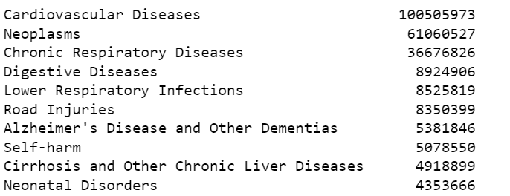
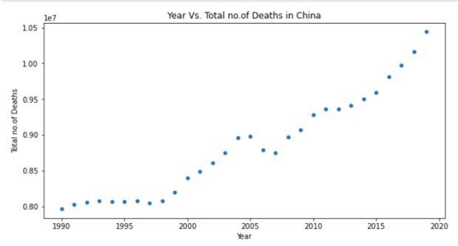
Visualize data of China
Year-wise deaths in china
Top 10 main cause of deaths

Slide 6
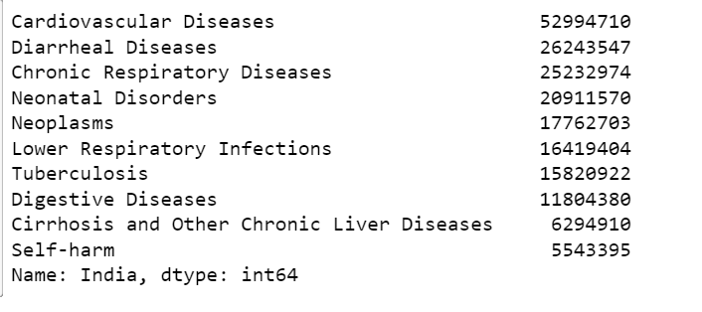
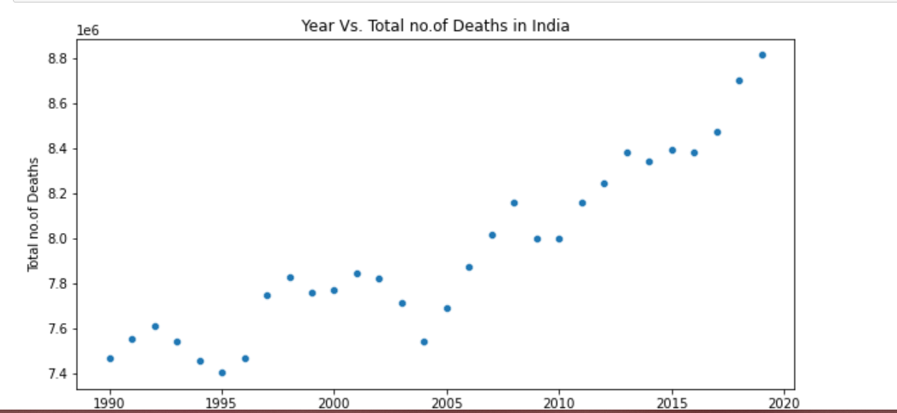
Visualize the data of India
Year-wise deaths in India
Top 10 main cause of deaths in India

Slide 7
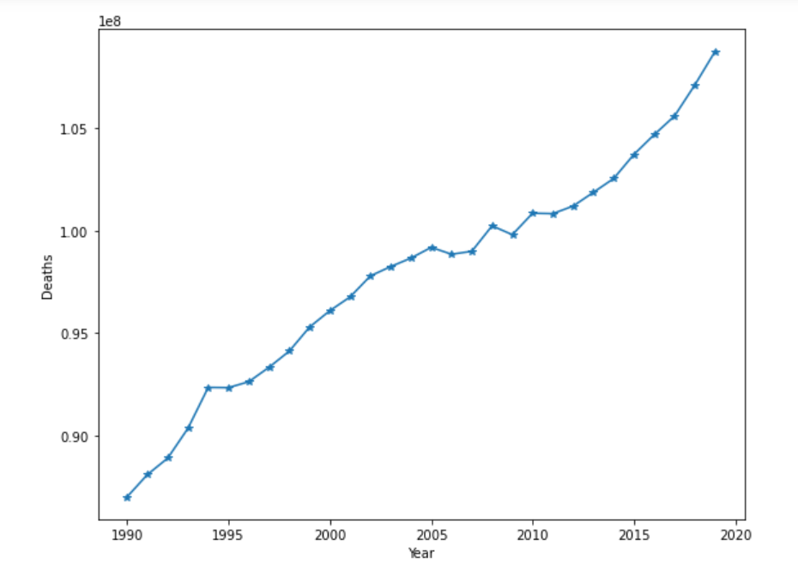
Year with maximum number of deaths

Slide 8
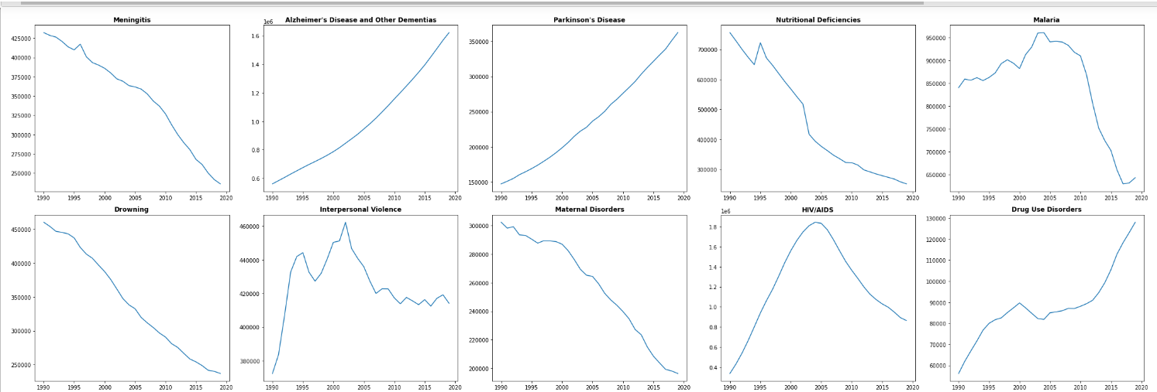
Year-wise Cause of Deaths

Slide 9
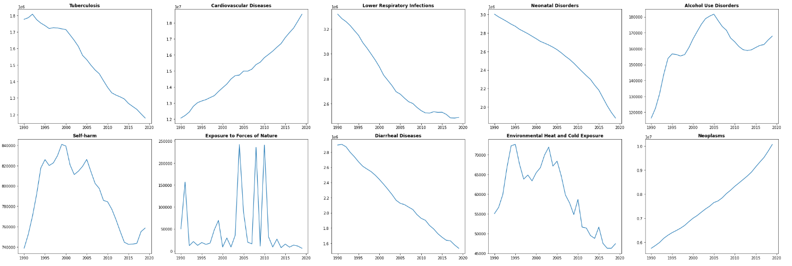

Slide 10
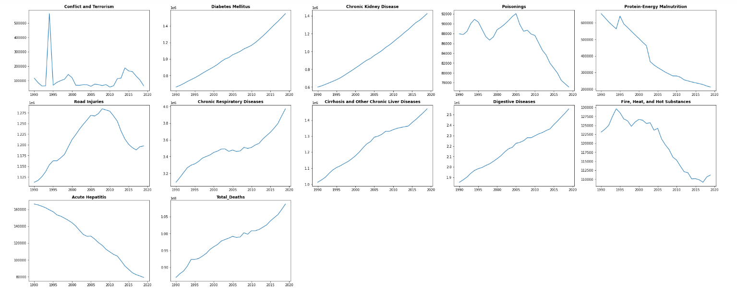

Slide 11
Thank You

